Slide 1

Apex Institute of Technology
Department of Computer Science & Engineering
Computer Networks
(CST-335)
Dr.Monica Luthra
E9836
Assistant Professor
CSE(AIT), CU
DISCOVER . LEARN . EMPOWER

Slide 2

Course Objectives
CO Number | Title
CO1 | Describe the important networking concepts
CO2 | Understand concept of network reference models and protocols
CO3 | Apply the concepts of routing algorithms on various networks
CO4 | Identify mechanism to handle traffic and control on congestion
CO5 | Identify and understand connection establishment techniques and features

Slide 3

Course Outcomes
After this course student will be able to:
To bring together several key of Computer network design and architecture
To Familiarize the student with the basic taxonomy and terminology of the computer networking area.
To Allow the student to gain expertise in some specific areas of networking such as the design and maintenance of individual networks.

Slide 4
Contents to be Covered
Routing Algorithms
Distance Vector Routing algorithm
Link state Routing algorithm
Hierarchical routing
Broadcast Routing

Slide 5
Routing Algorithms
A routing algorithm is a procedure that lays down the route or path to transfer data packets from source to the destination. They help in directing Internet traffic efficiently. After a data packet leaves its source, it can choose among the many different paths to reach its destination. Routing algorithm mathematically computes the best path, i.e. “least – cost path” that the packet can be routed through.

Slide 6
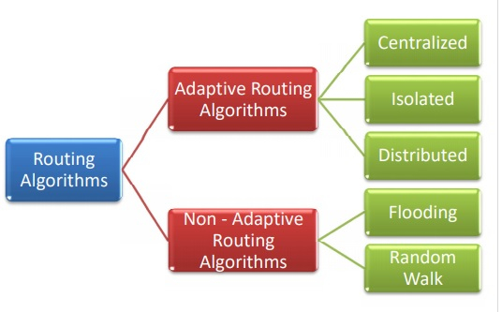
Types of Routing Algorithms
Source : https://www.tutorialspoint.com/what-is-a-routing-algorithm-in-computer-network/

Slide 7
Distance Vector Routing Algorithm
Distance Vector Routing Algorithm
The Distance vector algorithm is iterative, asynchronous and distributed.
Distributed: It is distributed in that each node receives information from one or more of its directly attached neighbors, performs calculation and then distributes the result back to its neighbors.
Iterative: It is iterative in that its process continues until no more information is available to be exchanged between neighbors.
Asynchronous: It does not require that all of its nodes operate in the lock step with each other.
The Distance vector algorithm is a dynamic algorithm.
It is mainly used in ARPANET, and RIP.

Slide 8
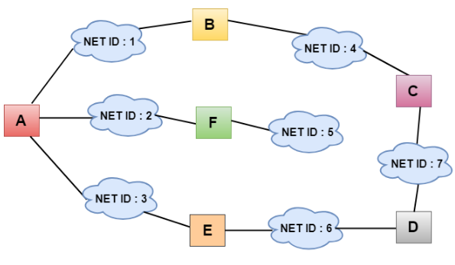
Distance Vector Routing Algorithm
With the Distance Vector Routing algorithm, the node x contains the following routing information:
For each neighbor v, the cost c(x,v) is the path cost from x to directly attached neighbor, v.
The distance vector x, i.e., D_{x} = [ D_{x}(y) : y in N ], containing its cost to all destinations, y, in N.
The distance vector of each of its neighbors, i.e., D_{v} = [ D_{v}(y) : y in N ] for each neighbor v of x.
Distance vector routing is an asynchronous algorithm in which node x sends the copy of its distance vector to all its neighbors. When node x receives the new distance vector from one of its neighboring vector, v, it saves the distance vector of v and uses the Bellman-Ford equation to update its own distance vector
Source : https://www.javatpoint.com/distance-vector-routing-algorithm?__cf_chl_managed_tk__=pmd_6666b1077c5eba403f57d13422b6d2276758fba2-1628492936-0-gqNtZGzNAuKjcnBszQ3i/

Slide 9
Link State Routing
Link state routing is a technique in which each router shares the knowledge of its neighborhood with every other router in the internetwork.
The three keys to understand the Link State Routing algorithm:
Knowledge about the neighborhood: Instead of sending its routing table, a router sends the information about its neighborhood only. A router broadcast its identities and cost of the directly attached links to other routers.
Flooding: Each router sends the information to every other router on the internetwork except its neighbors. This process is known as Flooding. Every router that receives the packet sends the copies to all its neighbors. Finally, each and every router receives a copy of the same information.
Information sharing: A router sends the information to every other router only when the change occurs in the information.

Slide 10
Link State Routing
Link State Routing has two phases:
Reliable Flooding
Initial state: Each node knows the cost of its neighbors.
Final state: Each node knows the entire graph.
Route Calculation
Each node uses Dijkstra's algorithm on the graph to calculate the optimal routes to all nodes.
The Link state routing algorithm is also known as Dijkstra's algorithm which is used to find the shortest path from one node to every other node in the network.
The Dijkstra's algorithm is an iterative, and it has the property that after k^{th} iteration of the algorithm, the least cost paths are well known for k destination nodes.

Slide 11
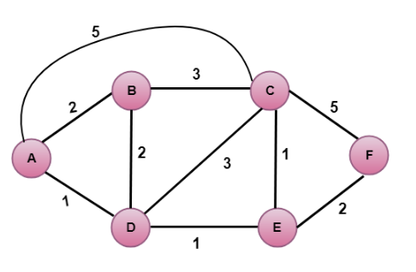
example
Source : https://www.tutorialspoint.com/data_communication_computer_network/network_layer_routing.htm

Slide 12
Hierarchical Routing
This is essentially a 'Divide and Conquer' strategy. The network is divided into different regions and a router for a particular region knows only about its own domain and other routers. Thus, the network is viewed at two levels:
The Sub-network level, where each node in a region has information about its peers in the same region and about the region's interface with other regions. Different regions may have different 'local' routing algorithms. Each local algorithm handles the traffic between nodes of the same region and also directs the outgoing packets to the appropriate interface.
The Network Level, where each region is considered as a single node connected to its interface nodes. The routing algorithms at this level handle the routing of packets between two interface nodes, and is isolated from intra-regional transfer.
Networks can be organized in hierarchies of many levels; e.g. local networks of a city at one level, the cities of a country at a level above it, and finally the network of all nations.In Hierarchical routing, the interfaces need to store information about:
All nodes in its region which are at one level below it.
Its peer interfaces.
At least one interface at a level above it, for outgoing packages.

Slide 13
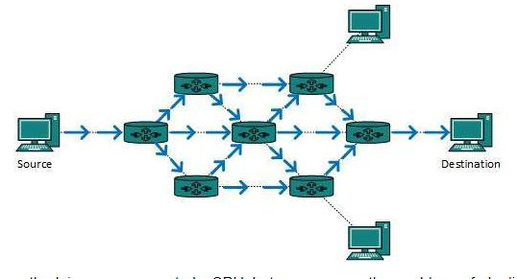
Broadcast routing
By default, the broadcast packets are not routed and forwarded by the routers on any network. Routers create broadcast domains. But it can be configured to forward broadcasts in some special cases. A broadcast message is destined to all network devices.
Broadcast routing can be done in two ways (algorithm):
A router creates a data packet and then sends it to each host one by one. In this case, the router creates multiple copies of single data packet with different destination addresses. All packets are sent as unicast but because they are sent to all, it simulates as if router is broadcasting.
This method consumes lots of bandwidth and router must destination address of each node.
Secondly, when router receives a packet that is to be broadcasted, it simply floods those packets out of all interfaces. All routers are configured in the same way.
Source : https://www.tutorialspoint.com/data_communication_computer_network/network_layer_routing.htm

Slide 14
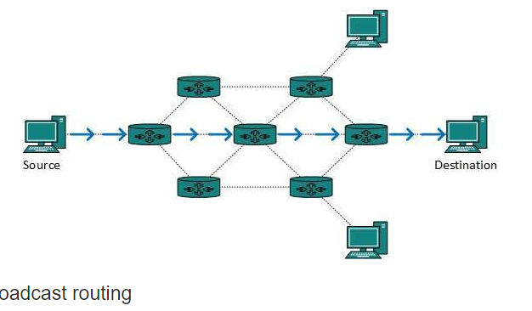
Unicast routing
Most of the traffic on the internet and intranets known as unicast data or unicast traffic is sent with specified destination. Routing unicast data over the internet is called unicast routing. It is the simplest form of routing because the destination is already known. Hence the router just has to look up the routing table and forward the packet to next hop.
Source : https://www.tutorialspoint.com/data_communication_computer_network/network_layer_routing.htm

Slide 15

Key Points
Network protocols are a set of rules, conventions, and data structures that dictate how devices exchange data across networks.
IPv4 is a network layer protocol that contains addressing and control information, which helps packets be routed in a network.
IP version 6 is the new version of Internet Protocol, which is way better than IP version 4 in terms of complexity and efficiency.
Next Header indicates type of extension header(if present) immediately following the IPv6 header.
Destination Address field indicates the IPv6 address of the final destination(in most cases).

Slide 16
Thank you
Please Send Your Queries on:
e-Mail: monica.e9836@cumail.in

